Slide 1
Introduction to Algorithms Shortest Paths
CSE 680
Prof. Roger Crawfis

Slide 2
Shortest Path
Given a weighted directed graph, one common problem is finding the shortest path between two given vertices
Recall that in a weighted graph, the length of a path is the sum of the weights of each of the edges in that path

Slide 3
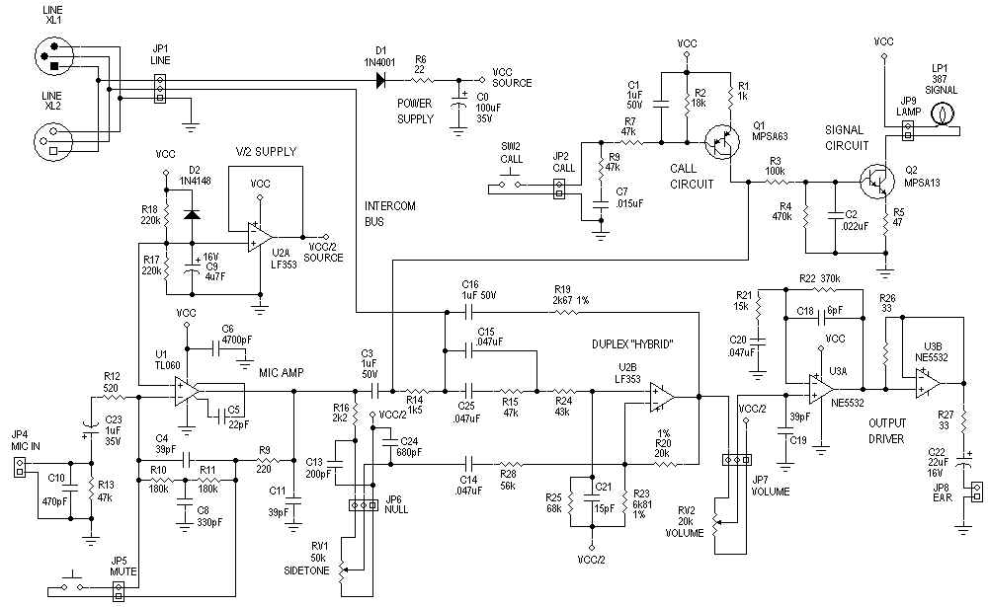
Applications
One application is circuit design: the time it takes for a change in input to affect an output depends on the shortest path
http://www.hp.com/

Slide 4
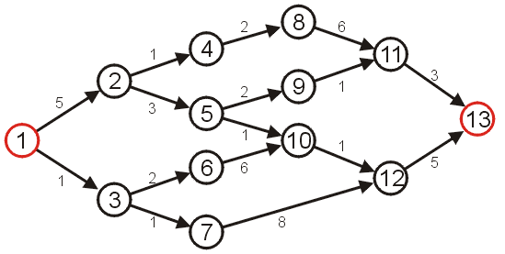
Shortest Path
Given the graph below, suppose we wish to find the shortest path from vertex 1 to vertex 13

Slide 5
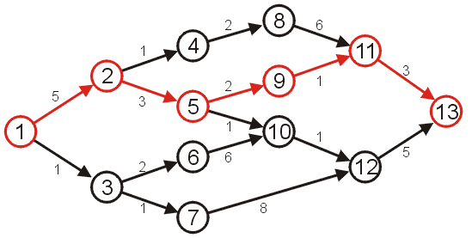
Shortest Path
After some consideration, we may determine that the shortest path is as follows, with length 14
Other paths exists, but they are longer

Slide 6
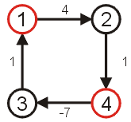
Negative Cycles
Clearly, if we have negative vertices, it may be possible to end up in a cycle whereby each pass through the cycle decreases the total length
Thus, a shortest length would be undefined for such a graph
Consider the shortest path from vertex 1 to 4...
We will only consider non- negative weights.

Slide 7
Shortest Path Example
Given:
Weighted Directed graph G = (V, E).
Source s, destination t.
Find shortest directed path from s to t.
2
23
3
9
Cost of path s-2-3-5-t = 9 + 23 + 2 + 16 = 48.
s
18
14
2
6
6
30
4
19
15
5
11
5
6
20
16
7
t
44

Slide 8
Discussion Items
How many possible paths are there from s to t?
Can we safely ignore cycles? If so, how?
Any suggestions on how to reduce the set of possibilities?
Can we determine a lower bound on the complexity like we did for comparison sorting?
2
23
3
9
s
18
14
2
6
6
30
4
19
15
5
11
5
6
20
16
7
t
44

Slide 9
Key Observation
A key observation is that if the shortest path contains the node v, then:
It will only contain v once, as any cycles will only add to the length.
The path from s to v must be the shortest path to v from s.
The path from v to t must be the shortest path to t from v.
Thus, if we can determine the shortest path to all other vertices that are adjecent to the target vertex we can easily compute the shortest path.
Implies a set of sub-problems on the graph with the target vertex removed.

Slide 10
Dijkstra’s Algorithm
Works when all of the weights are positive.
Provides the shortest paths from a source to all other vertices in the graph.
Can be terminated early once the shortest path to t is found if desired.

Slide 11
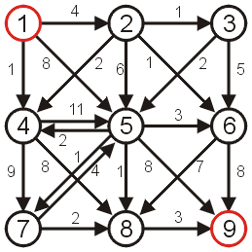
Shortest Path
Consider the following graph with positive weights and cycles.

Slide 12
Dijkstra’s Algorithm
A first attempt at solving this problem might require an array of Boolean values, all initially false, that indicate whether we have found a path from the source.
1 | F
2 | F
3 | F
4 | F
5 | F
6 | F
7 | F
8 | F
9 | F

Slide 13
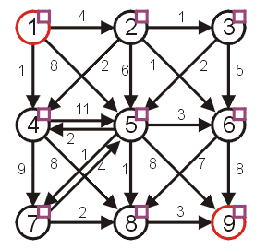
Dijkstra’s Algorithm
Graphically, we will denote this with check boxes next to each of the vertices (initially unchecked)

Slide 14
Dijkstra’s Algorithm
We will work bottom up.
Note that if the starting vertex has any adjacent edges, then there will be one vertex that is the shortest distance from the starting vertex. This is the shortest reachable vertex of the graph.
We will then try to extend any existing paths to new vertices.
Initially, we will start with the path of length 0
this is the trivial path from vertex 1 to itself

Slide 15
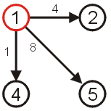
Dijkstra’s Algorithm
If we now extend this path, we should consider the paths
(1, 2) length 4
(1, 4) length 1
(1, 5) length 8
The shortest path so far is (1, 4) which is of length 1.

Slide 16
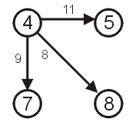
Dijkstra’s Algorithm
Thus, if we now examine vertex 4, we may deduce that there exist the following paths:
(1, 4, 5) length 12
(1, 4, 7) length 10
(1, 4, 8) length 9

Slide 17
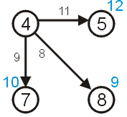
Dijkstra’s Algorithm
We need to remember that the length of that path from node 1 to node 4 is 1
Thus, we need to store the length of a path that goes through node 4:
5 of length 12
7 of length 10
8 of length 9

Slide 18
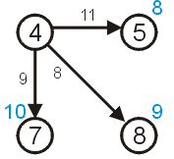
Dijkstra’s Algorithm
We have already discovered that there is a path of length 8 to vertex 5 with the path (1, 5).
Thus, we can safely ignore this longer path.

Slide 19
Dijkstra’s Algorithm
We now know that:
There exist paths from vertex 1 to vertices {2,4,5,7,8}.
We know that the shortest path from vertex 1 to vertex 4 is of length 1.
We know that the shortest path to the other vertices {2,5,7,8} is at most the length listed in the table to the right.
Vertex | Length
1 | 0
2 | 4
4 | 1
5 | 8
7 | 10
8 | 9

Slide 20
Dijkstra’s Algorithm
There cannot exist a shorter path to either of the vertices 1 or 4, since the distances can only increase at each iteration.
We consider these vertices to be visited
Vertex | Length
1 | 0
2 | 4
4 | 1
5 | 8
7 | 10
8 | 9
If you only knew this information and nothing else about the graph, what is the possible lengths from vertex 1 to vertex 2? What about to vertex 7?

Slide 21
Relaxation
Maintaining this shortest discovered distance d[v] is called relaxation:
Relax(u,v,w) {
if (d[v] > d[u]+w) then
d[v]=d[u]+w;
}
5
2
9
5
2
6
u
Relax
v
u
Relax
v
5
2
7
5
2
6

Slide 22
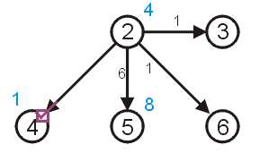
Dijkstra’s Algorithm
In Dijkstra’s algorithm, we always take the next unvisited vertex which has the current shortest path from the starting vertex in the table.
This is vertex 2

Slide 23
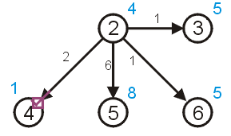
Dijkstra’s Algorithm
We can try to update the shortest paths to vertices 3 and 6 (both of length 5) however:
there already exists a path of length 8 < 10 to vertex 5 (10 = 4 + 6)
we already know the shortest path to 4 is 1

Slide 24
Dijkstra’s Algorithm
To keep track of those vertices to which no path has reached, we can assign those vertices an initial distance of either
infinity (∞ ),
a number larger than any possible path, or
a negative number
For demonstration purposes, we will use ∞

Slide 25
Dijkstra’s Algorithm
As well as finding the length of the shortest path, we’d like to find the corresponding shortest path
Each time we update the shortest distance to a particular vertex, we will keep track of the predecessor used to reach this vertex on the shortest path.

Slide 26
Dijkstra’s Algorithm
We will store a table of pointers, each initially 0
This table will be updated each time a distance is updated
1 | 0
2 | 0
3 | 0
4 | 0
5 | 0
6 | 0
7 | 0
8 | 0
9 | 0

Slide 27
Dijkstra’s Algorithm
Graphically, we will display the reference to the preceding vertex by a red arrow
if the distance to a vertex is ∞, there will be no preceding vertex
otherwise, there will be exactly one preceding vertex

Slide 28
Dijkstra’s Algorithm
Thus, for our initialization:
we set the current distance to the initial vertex as 0
for all other vertices, we set the current distance to ∞
all vertices are initially marked as unvisited
set the previous pointer for all vertices to null

Slide 29
Dijkstra’s Algorithm
Thus, we iterate:
find an unvisited vertex which has the shortest distance to it
mark it as visited
for each unvisited vertex which is adjacent to the current vertex:
add the distance to the current vertex to the weight of the connecting edge
if this is less than the current distance to that vertex, update the distance and set the parent vertex of the adjacent vertex to be the current vertex

Slide 30
Dijkstra’s Algorithm
Halting condition:
we successfully halt when the vertex we are visiting is the target vertex
if at some point, all remaining unvisited vertices have distance ∞, then no path from the starting vertex to the end vertex exits
Note: We do not halt just because we have updated the distance to the end vertex, we have to visit the target vertex.

Slide 31
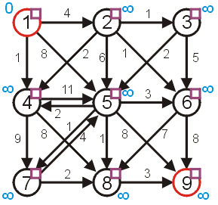
Example
Consider the graph:
the distances are appropriately initialized
all vertices are marked as being unvisited

Slide 32
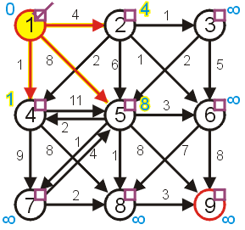
Example
Visit vertex 1 and update its neighbours, marking it as visited
the shortest paths to 2, 4, and 5 are updated

Slide 33
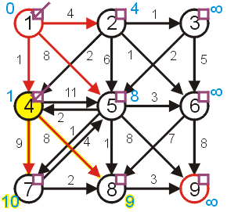
Example
The next vertex we visit is vertex 4
vertex 5 1 + 11 ≥ 8 don’t update
vertex 7 1 + 9 < ∞ update
vertex 8 1 + 8 < ∞ update

Slide 34
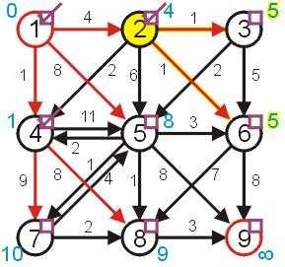
Example
Next, visit vertex 2
vertex 3 4 + 1 < ∞ update
vertex 4 already visited
vertex 5 4 + 6 ≥ 8 don’t update
vertex 6 4 + 1 < ∞ update

Slide 35
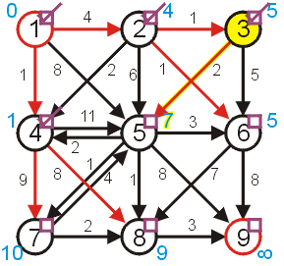
Example
Next, we have a choice of either 3 or 6
We will choose to visit 3
vertex 5 5 + 2 < 8 update
vertex 6 5 + 5 ≥ 5 don’t update

Slide 36
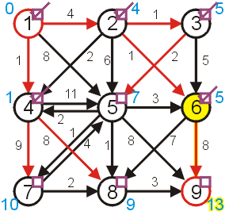
Example
We then visit 6
vertex 8 5 + 7 ≥ 9 don’t update
vertex 9 5 + 8 < ∞ update

Slide 37
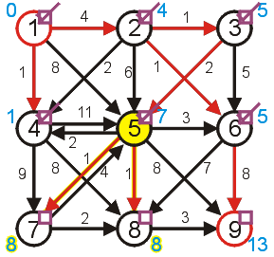
Example
Next, we finally visit vertex 5:
vertices 4 and 6 have already been visited
vertex 7 7 + 1 < 10 update
vertex 8 7 + 1 < 9 update
vertex 9 7 + 8 ≥ 13 don’t update

Slide 38
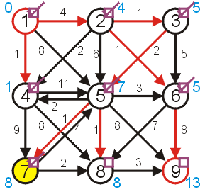
Example
Given a choice between vertices 7 and 8, we choose vertex 7
vertices 5 has already been visited
vertex 8 8 + 2 ≥ 8 don’t update

Slide 39
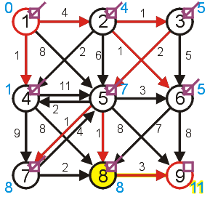
Example
Next, we visit vertex 8:
vertex 9 8 + 3 < 13 update

Slide 40
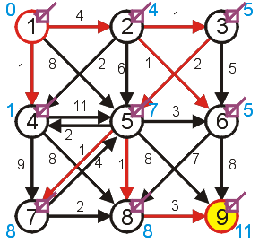
Example
Finally, we visit the end vertex
Therefore, the shortest path from 1 to 9 has length 11

Slide 41
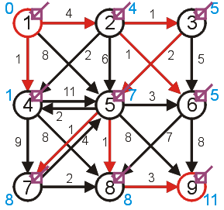
Example
We can find the shortest path by working back from the final vertex:
9, 8, 5, 3, 2, 1
Thus, the shortest path is (1, 2, 3, 5, 8, 9)

Slide 42
Example
In the example, we visited all vertices in the graph before we finished
This is not always the case, consider the next example

Slide 43
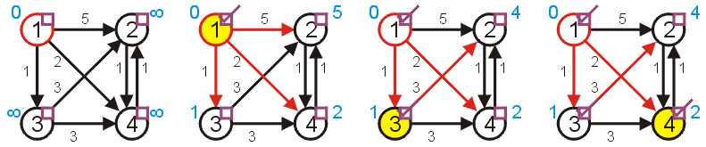
Example
Find the shortest path from 1 to 4:
the shortest path is found after only three vertices are visited
we terminated the algorithm as soon as we reached vertex 4
we only have useful information about 1, 3, 4
we don’t have the shortest path to vertex 2

Slide 44
Dijkstra’s algorithm
d[s] ← 0
for each v ∈ V – {s}
do d[v] ← ∞
S ← ∅
Q ← V ⊳ Q is a priority queue maintaining V – S
while Q ≠ ∅
do u ← EXTRACT-MIN(Q)
S ← S ∪ {u}
for each v ∈ Adj[u]
do if d[v] > d[u] + w(u, v)
then d[v] ← d[u] + w(u, v)
p[v] ← u

Slide 45
Dijkstra’s algorithm
d[s] ← 0
for each v ∈ V – {s}
do d[v] ← ∞
S ← ∅
Q ← V ⊳ Q is a priority queue maintaining V – S
while Q ≠ ∅
do u ← EXTRACT-MIN(Q)
S ← S ∪ {u}
for each v ∈ Adj[u]
do if d[v] > d[u] + w(u, v)
then d[v] ← d[u] + w(u, v)
p[v] ← u
relaxation step
Implicit DECREASE-KEY

Slide 46
Example of Dijkstra’s algorithm
2
Graph with nonnegative edge weights:
B
D
10
A
8
1
4
7
9
3
C
E
2

Slide 47
Example of Dijkstra’s algorithm
∞
∞
Initialize:
2
B
D
10
A
8
0
1
4
7
9
3
Q:
A
B
C
D
E
C
E
2
0
∞
∞
∞
∞
∞
∞
S: {}

Slide 48
Example of Dijkstra’s algorithm
∞
∞
“A” ← EXTRACT-MIN(Q):
2
B
D
10
A
8
0
1
4
7
9
3
Q:
A
B
C
D
E
C
E
2
0
∞
∞
∞
∞
∞
∞
S: { A }

Slide 49
Example of Dijkstra’s algorithm
10
∞
Relax all edges leaving A:
2
B
D
10
A
8
0
1
4
7
9
3
Q:
A
B
C
D
E
C
E
2
0
∞
∞
∞
∞
3
∞
10
3
∞
∞
S: { A }

Slide 50
Example of Dijkstra’s algorithm
10
∞
“C” ← EXTRACT-MIN(Q):
2
B
D
10
A
8
0
1
4
7
9
3
Q:
A
B
C
D
E
C
E
2
0
∞
∞
∞
∞
3
∞
10
3
∞
∞
S: { A, C }

Slide 51
Example of Dijkstra’s algorithm
7
11
Relax all edges leaving C:
2
B
D
10
A
8
0
1
4
7
9
3
Q:
A
B
C
D
E
C
E
2
0
∞
∞
∞
∞
3
5
10
3
∞
∞
7
11
5
S: { A, C }

Slide 52
Example of Dijkstra’s algorithm
7
11
“E” ← EXTRACT-MIN(Q):
2
B
D
10
A
8
0
1
4
7
9
3
Q:
A
B
C
D
E
C
E
2
0
∞
∞
∞
∞
3
5
10
3
∞
∞
7
11
5
S: { A, C, E }

Slide 53
Example of Dijkstra’s algorithm
7
11
Relax all edges leaving E:
2
B
D
10
A
8
0
1
4
7
9
3
Q:
A
B
C
D
E
C
E
2
0
∞
∞
∞
∞
3
5
10
3
∞
∞
7
11
5
S: { A, C, E }
7
11

Slide 54
Example of Dijkstra’s algorithm
7
11
“B” ← EXTRACT-MIN(Q):
2
B
D
10
A
8
0
1
4
7
9
3
Q:
A
B
C
D
E
C
E
2
0
∞
∞
∞
∞
3
5
10
3
∞
∞
7
11
5
S: { A, C, E, B }
7
11

Slide 55
Example of Dijkstra’s algorithm
7
9
Relax all edges leaving B:
2
B
D
10
A
8
0
1
4
7
9
3
Q:
A
B
C
D
E
C
E
2
0
∞
∞
∞
∞
3
5
10
3
∞
∞
7
11
5
S: { A, C, E, B }
7
11
9

Slide 56
Example of Dijkstra’s algorithm
7
9
“D” ← EXTRACT-MIN(Q):
2
B
D
10
A
8
0
1
4
7
9
3
Q:
A
B
C
D
E
C
E
2
0
∞
∞
∞
∞
3
5
10
3
∞
∞
7
11
5
S: { A, C, E, B, D }
7
11
9

Slide 57
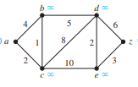
Find the shortest path between a to z using Dijkstra's algorithm

Slide 58
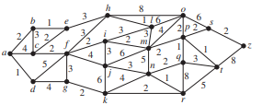
Find the shortest path between a to z using Dijkstra's algorithm

Slide 59
Summary
Given a weighted directed graph, we can find the shortest distance between two vertices by:
starting with a trivial path containing the initial vertex
growing this path by always going to the next vertex which has the shortest current path

Slide 60
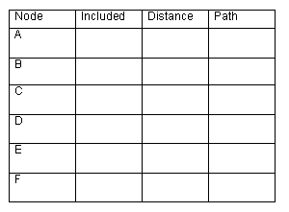
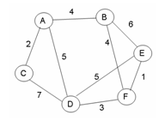
Practice
-
-
t
f
t
4
A
f
t
2
A
f
t
5
A
∞
-
B
F
f
t
10
9
f
t
∞
8
-
B
Give the shortest path tree for node A for this graph using Dijkstra’s shortest path algorithm. Show your work with the 3 arrays given and draw the resultant shortest path tree with edge weights included.

Slide 61
Bellman-Ford Algorithm
BellmanFord()
for each v ∈ V
d[v] = ∞;
d[s] = 0;
for i=1 to |V|-1
for each edge (u,v) ∈ E
Relax(u,v, w(u,v));
for each edge (u,v) ∈ E
if (d[v] > d[u] + w(u,v))
return “no solution”;
Relax(u,v,w): if (d[v] > d[u]+w) then d[v]=d[u]+w
Initialize d[] which
will converge to shortest-path value
Relaxation: Make |V|-1 passes,
relaxing each edge
Test for solution:
have we converged yet? Ie, ∃ negative cycle?

Slide 62
DAG Shortest Paths
Bellman-Ford takes O(VE) time.
For finding shortest paths in a DAG, we can do much better by using a topological sort.
If we process vertices in topological order, we are guaranteed to never relax a vertex unless the adjacent edge is already finalized. Thus: just one pass. O(V+E)
DAG-Shortest-Paths(G, w, s)
topologically sort the vertices of G
INITIALIZE-SINGLE-SOURCE(G, s)
for each vertex u, taken in topologically sorted order
do for each vertex v ∈ Adj[u]
do Relax(u, v, w)

Slide 63
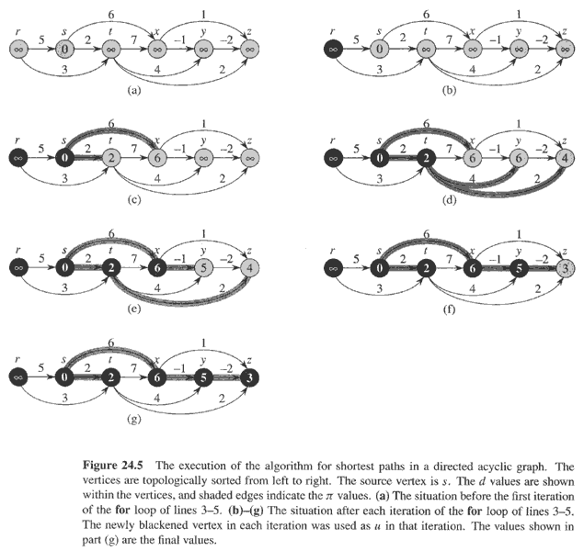
DAG Shortest Paths

Slide 64
private IEnumerable<int> TraverseComponent( int startingNode )
{
activeList.Put(startingNode);
while (activeList.Count > 0)
{
int currentNode = activeList.GetNext();
if (!visited[currentNode])
{
visited[currentNode] = true;
if (this.TraversalOrder == Graph.TraversalOrder.PreOrder)
yield return currentNode;
foreach (int node in indexedGraph.Neighbors(currentNode))
{
if (!visited[node])
{
activeList.Put(node);
}
}
if (this.TraversalOrder == Graph.TraversalOrder.PostOrder)
yield return currentNode;
}
}
}

Slide 65

Usage Notes
These slides are made publicly available on the web for anyone to use
If you choose to use them, or a part thereof, for a course at another institution, I ask only three things:
that you inform me that you are using the slides,
that you acknowledge my work, and
that you alert me of any mistakes which I made or changes which you make, and allow me the option of incorporating such changes (with an acknowledgment) in my set of slides
Sincerely,
Douglas Wilhelm Harder, MMath
dwharder@alumni.uwaterloo.ca

